Slide 1
Secondary Transfer 2025 Meeting
20th June 2024
Richard Newsome

Slide 2
Session Aims
To provide an overview of the procedures for applying for secondary schools;
To hear from local secondary schools what they can offer you and your child;
To ask questions about the application process or about specific schools.

Slide 3
Application Procedures
Check the key dates on these slides to ensure that you give yourself good time to make decisions;
Visit any schools in which you are interested – where possible, do this during the school day;
Check schools’ admissions criteria, including for those of a religious character or with specialisms;
Visit schools’ websites to see if there are additional forms you must complete for individual schools.

Slide 4
Online Application
Applications must be completed online via the online portal;
If you have already applied for an elder sibling in a previous year, you will need to use the same logon;
If you have twins, you will need to add details for both children;
You will be able to apply for six schools: we advise that you add as many choices as possible.

Slide 5
Application Dates
September/October 2024: schools open for visits (check their websites for information);
Sunday 1st September 2024: school applications open online;
Sunday 20th October 2024: recommended date to submit application;
Thursday 31st October 2024: final deadline for applications and any supplementary forms.

Slide 6
EHCP Application
If you have not already been contacted, Lewisham SEN will contact you. If you missed yesterday’s meeting or if you have any further questions, contact Sai Satyadeva (SENCo);
Applications (first and second choices) need to be made by Wednesday 2nd October;
The LA and SEN team will contact parents/carers following application and consultation.

Slide 7
Online Platforms
The Lewisham secondary admissions website contains a host of useful information: https://lewisham.gov.uk/myservices/education/schools/school-admission/applying-to-start-secondary-school;
Applications are to be submitted here: https://www.eadmissions.org.uk/.

Slide 8
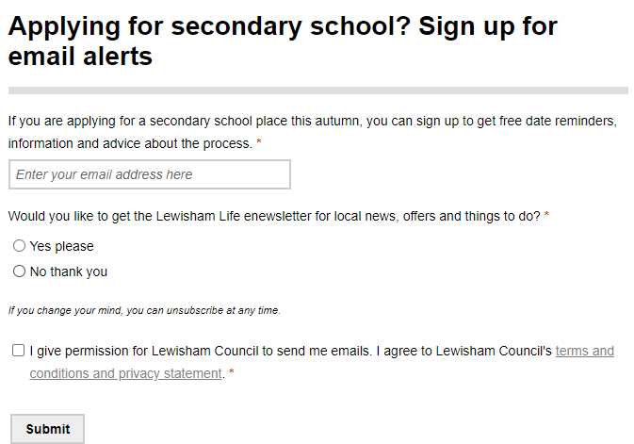
Online Application

Slide 9
Visiting Schools
We strongly recommend that you visit schools in which you are interested;
Try to get into schools during the day so that you can see them ‘in action’;
Any schools visits during the day will be authorised – please inform our school office in advance;
If your child is required to sit an entrance examination, this will also be authorised.

Slide 10
Tips on Making Choices
Be realistic – consider catchment areas or any other admission criteria to see whether it is likely that your son/daughter will be offered a place;
Keep an open mind – some Lewisham secondary schools may have suffered from poor reputations historically. These are not always accurate;
Be critical of what you read – OFSTED reports and other information may be out of date.

Slide 11
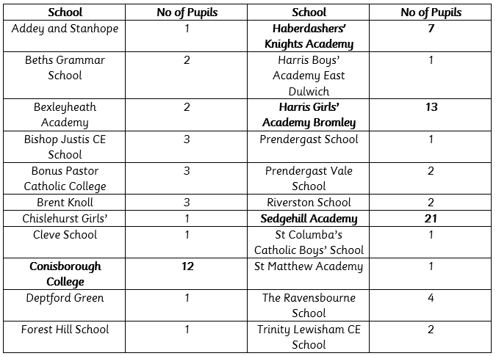
Torridon Destinations 2024

Slide 12
Speakers from Schools
Bonus Pastor Catholic College – Mr Nick Lawrence;
Conisborough College – Mr John Cavadino;
Haberdashers’ Knights Academy – Mr Steve Grant;
St Matthew Academy – Ms Brooke Hollett;

Slide 13
Any Questions?

