Slide 1
Safer
Internet
Day

Slide 2
Safer
Internet
Day
Notes:
Hello everyone. In today’s assembly we’re going to be talking about Safer Internet Day. What do you think Safer Internet Day might be about?

Slide 3
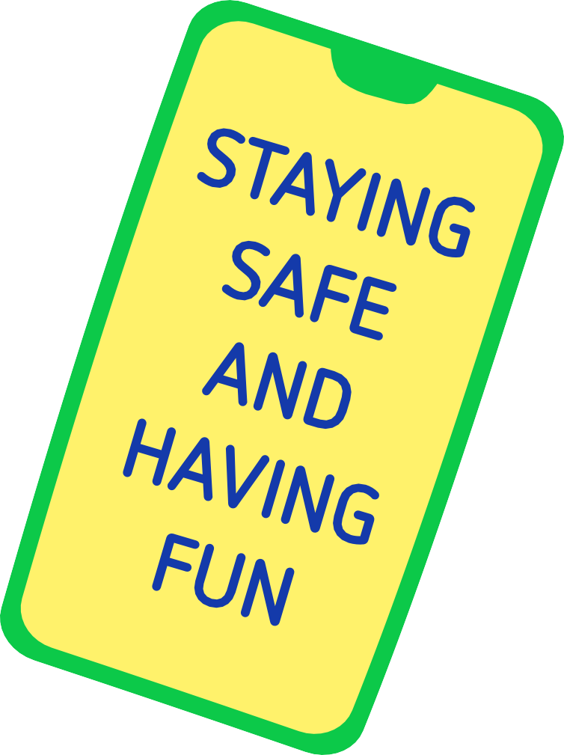
Notes:
Safer Internet Day is held every February all around the world. Last year over 170 different countries celebrated the day! Safer Internet Day is a chance to think about any worries we might have about using technology and the internet, but it’s also about celebrating all the fantastic things technology can help us with.
Last year, over half of the children in the UK heard about or joined in with Safer Internet Day.
Did you do anything to celebrate the day?

Slide 4
Notes:
And it’s not just schools who join in with the day, lots of other people get involved too, including the government, lots of charities, sports clubs, the police and even the companies who make your favourite apps and games.
By participating in this assembly, you’re joining thousands of others in marking the day!

Slide 5
Notes:
We want this year’s Safer Internet Day to be the biggest and best celebration yet! It’s so important to recognise all exciting and amazing things we can do online… maybe you like to play games, or chat with your friends. Maybe you use the internet to learn new things, or maybe you love watching videos.
What’s your favourite thing to do online?

Slide 6
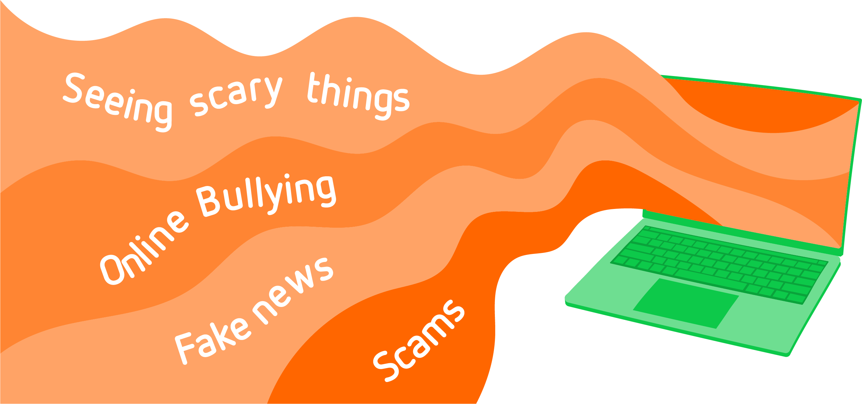
y
S
r
t
a
hi
c
n
s
ee
s
g
i
n
g
l yi
n
u
l
B
e
n
i
l
n
s
O
w
e
n
s
e
m
k
a
a
F
c
S
Notes:
Although there are lots of incredible things to do online, the internet isn’t perfect and sometimes people use it in ways that are not safe, kind or responsible. Maybe you or your friends have seen things go wrong online. Safer Internet Day is a good chance to think about online issues, and what we can all do to make the internet a safer place.
What online issues have you seen or heard about?
[Note to educators: if a learner discloses something that might be a safeguarding concern, then follow the recommend procedures within your setting. For further advice on handling disclosures visit: childnet.com/safeguarding]

Slide 7
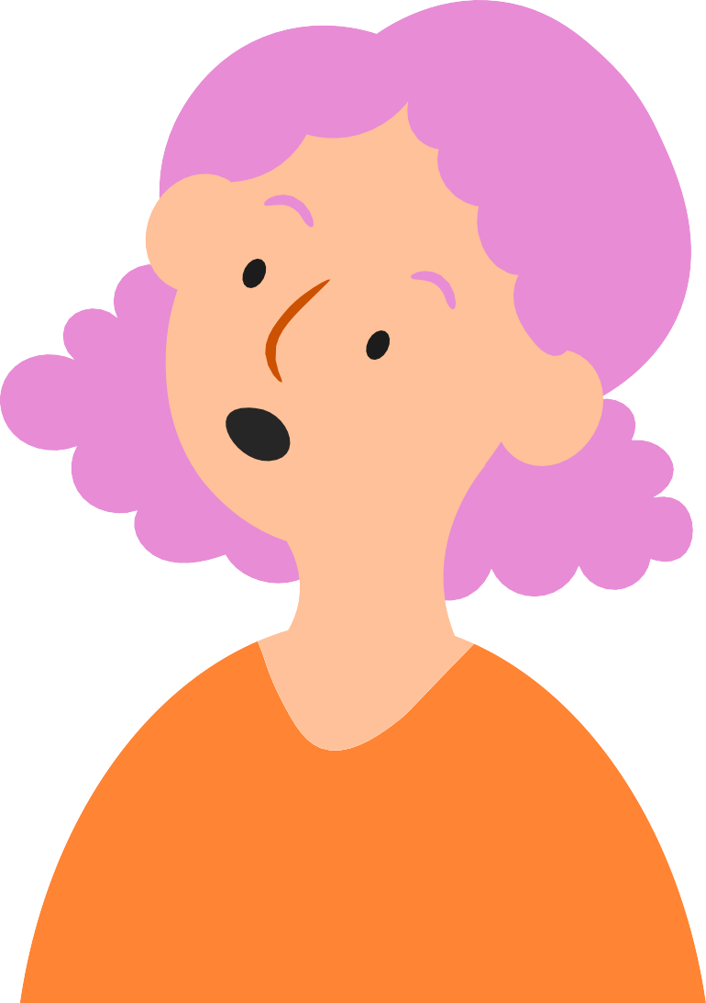
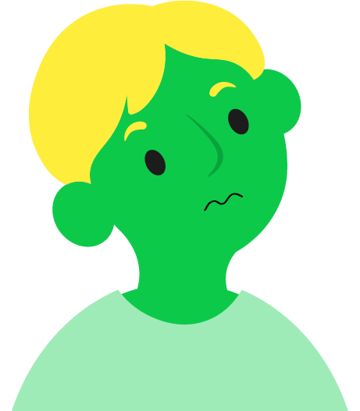
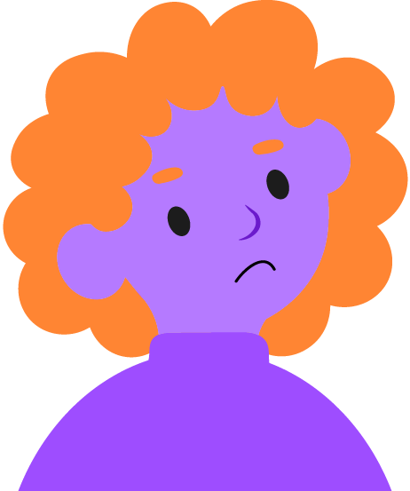
Notes:
It’s really important that all children and young people like you get to share their opinions and experiences of going online – the good and the bad.
That’s why this year, the theme for Safer Internet Day is: Want to talk about it? Making space for conversations about life online

Slide 8
Notes:
Communicating with each other can help us all work better together. Whether that’s speaking, using sign language, writing someone a note, or whatever method you use! You probably already spend lots of your time chatting with different people in your life.
What benefits or good reasons can you think of for talking to other people?

Slide 9
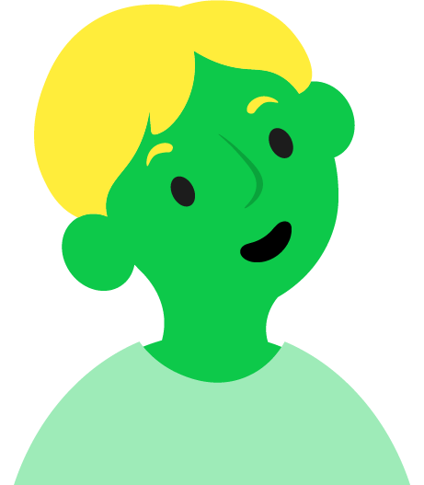
Notes:
[Take responses from learners and click to reveal answers.]
It’s a way to connect and bond with other people
It’s a chance to learn new things and ask questions
It’s a way to share information and ideas
You can get help when things go wrong
It’s fun!
All of these reasons and more show that communicating is not only important but can make our lives better too. It’s especially important if you ever have a worry or concern – telling someone can help you feel better and means you’re not on your own. Together you can work out what to do next.

Slide 10
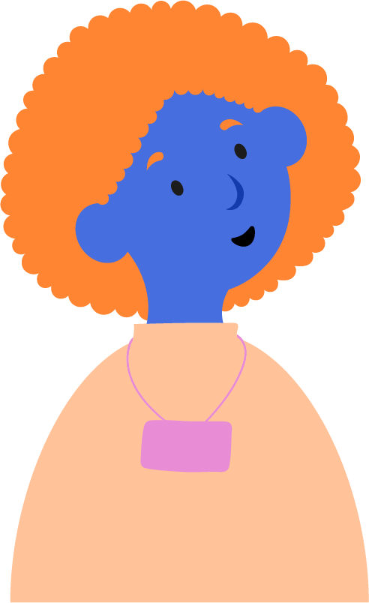
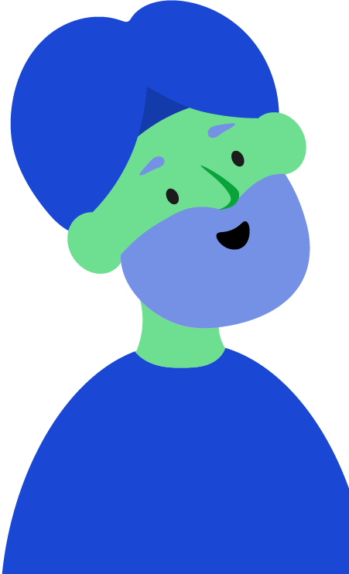
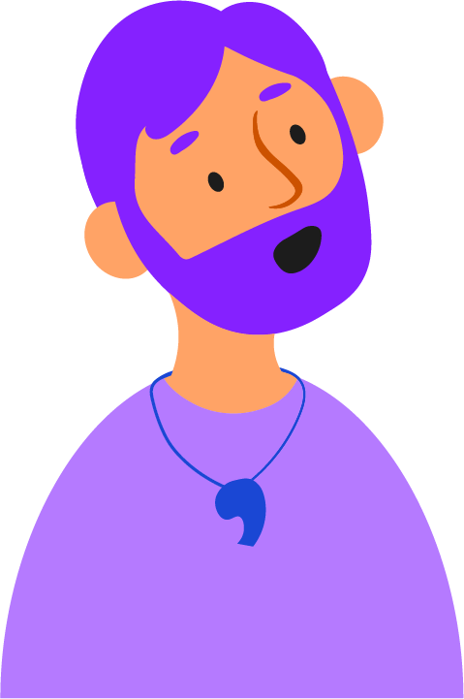
Notes:
Chatting with your friends about what you all enjoy doing online can be great fun and a lovely way to make your friendships stronger.
You can have the same kind of conversations with the adults you know and trust too! Talk to your parents, carers, teachers, and any other adult who looks after you about your favourite things to do online or share your top online safety tips to see what they think!
The more we talk about the things we see and do online, the easier it is for us all to support each other. It also means that if something ever does go wrong, it’s even easier to find someone to help.
Who do you have in your life you could talk to about going online?

Slide 11
Note to educators – add names, words or even photos to this slide to show learners who they can go to if they have an online safety concern.
Notes:
Here at [name of school/setting] part of our job is making sure you feel safe and happy, in all parts of your life – including online!
If you ever have a worry about something that’s happened online, you can come to us for help and advice. We’ll always listen carefully and give you some ideas of what you can do. Sometimes, if we’re worried that you or somebody else might be in danger, we have to pass on what you’ve told us to a special member of staff. At [name of school/setting] that person is [name of staff member with safeguarding responsibility].
If we have to speak to them, it’s not because you’re in trouble, it’s just because they have the special job of making sure every child here is safe.

Slide 12
Notes:
So, this Safer Internet Day we have a special challenge for everyone in this room. We challenge you to talk about it!
Talk to your friends. Talk to the adults you know and trust.
Tell them about the funny things you see online, or your favourite game or app to use.
Tell them about the latest trends, or your favourite videos, or the trick to beating your favourite level in a game.
Tell them about the things online that frustrate you, or the things that make you laugh out loud.
Tell them about how you think they can best support you in your online life.
Most importantly, tell them if something is worrying you. It’s never too late to share an online problem and get help and support that can make things better.
Happy Safer Internet Day everyone!

