Slide 1
Safer
Internet
Day

Slide 2
Safer
Internet
Day
Notes:
Hello everyone. In today’s assembly we’re going to be talking about Safer Internet Day.

Slide 3
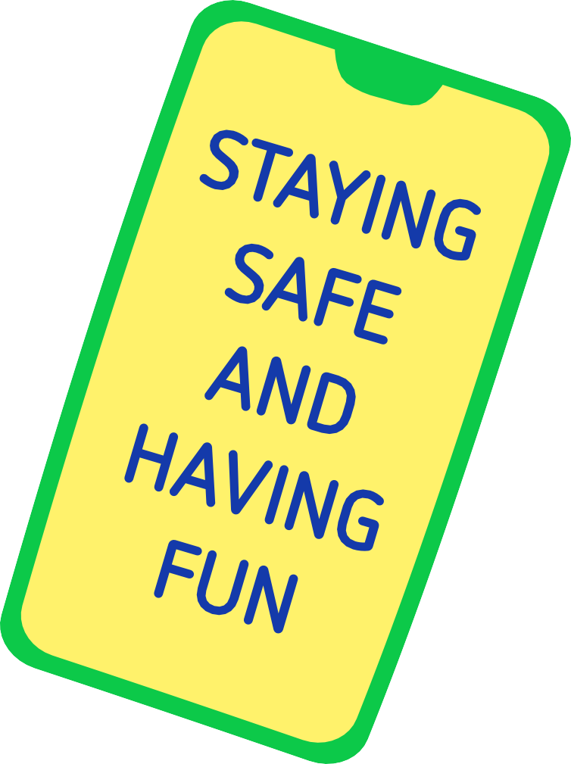
Notes:
Safer Internet Day is held every February all around the world. It’s a special day when we think about using the internet and technology.
Hands up if you have used a laptop.
Hands up if you have used a tablet like an iPad.
Hands up if you have ever been on Mum’s or Dad’s or someone else’s phone.
Hands up if you have ever used a games console like a Switch, an Xbox or a PlayStation.
Hands up if you have ever asked a smart speaker a question, like Alexa or Siri.
All of these devices and more can connect to the internet. That means we can do fantastic things like listen to music, play games, watch videos or chat with friends and family.
Safer Internet Day is a chance to celebrate all the amazing things technology can help us with, but also to think about any worries we might have going online.

Slide 4
Notes:
It’s not just schools who join in with the day, lots of other people get involved too, including the government, lots of charities, sports clubs, the police and even the companies who make your favourite apps and games.
By watching this assembly, you’re joining in with thousands of others in marking the day!

Slide 5
Notes:
We want this year’s Safer Internet Day to be the biggest and best yet! It’s so important to recognise all the exciting and amazing things we can do online… maybe you like to play games, or chat with your friends. Maybe you use the internet to learn new things, or maybe you love watching videos.
What’s your favourite thing to do online?

Slide 6
Notes:
Although there are lots of incredible things to do online, the internet isn’t perfect and sometimes people use it in ways that are unkind or unsafe. Maybe you or your friends have seen things go wrong online. Safer Internet Day is a good chance to think about online issues, and what we can all do to make the internet a safer place.

Slide 7
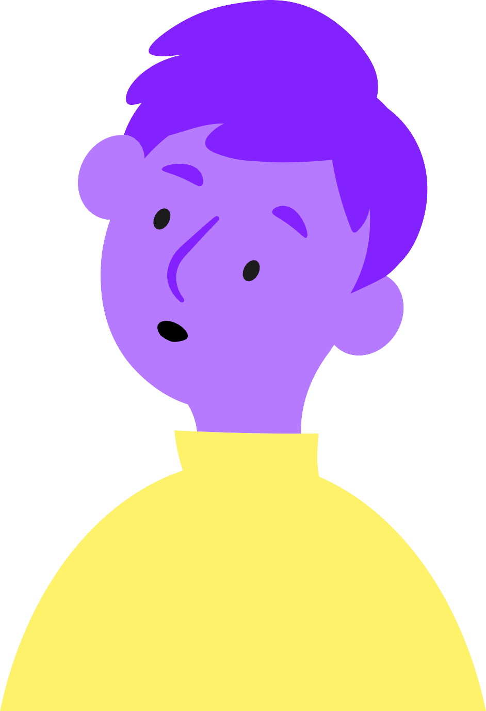
Notes:
There are lots of adults, at home and at school who want to support you. If we know more about what you do online, we can give you the best help if things go wrong.
That’s why this year, the theme for Safer Internet Day is:
Want to talk about it?

Slide 8
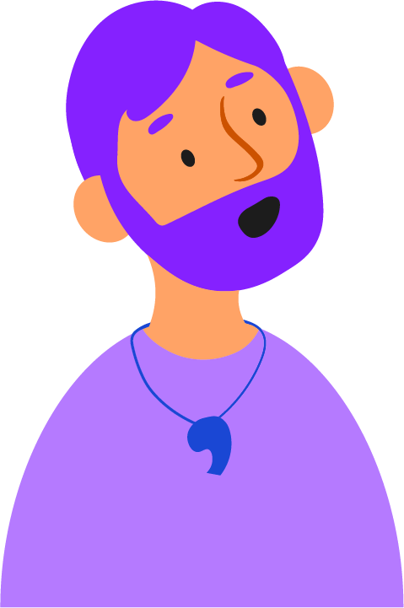
Notes:
Chatting with your friends about what you all enjoy doing online can be great fun and a lovely way to make your friendships stronger.
You can have the same kind of conversations with the adults you know and trust too! Talk to your parents, carers, teachers, and any other adult who looks after you about your favourite things to do online or share your top online safety tips to see what they think!
The more we talk about the things we see and do online, the easier it is for us all to support each other. It also means that if something ever does go wrong, it’s even easier to find someone to help.
Who do you have in your life you could talk to about going online?

Slide 9
Note to educators – add names, words or even photos to this slide to show learners who they can go to if they have an online safety concern.
Notes:
Here at [name of school/setting] part of our job is making sure you feel safe and happy, in all parts of your life – including online!
If you ever have a worry about something that’s happened online, you can come to us for help and advice. We’ll always listen carefully and give you help or advice. Sometimes, if we’re worried that you or somebody else might be in danger, we have to pass on what you’ve told us to a special member of staff. At [name of school/setting] that person is [name of staff member with safeguarding responsibility].
If we have to speak to them, it’s not because you’re in trouble, it’s just because they have the special job of making sure every child here is safe. We will only pass on that information to the people who absolutely have to know to help keep you safe.

Slide 10
Notes:
So, this Safer Internet Day we have a special challenge for everyone in this room. We challenge you to talk about it!
Talk to your friends and family. Talk to the adults you know and trust.
Tell them about the funny things you see online, or your favourite game or app to use.
Tell them about the things online that bother you, or the things that make you laugh out loud.
Most importantly, tell an adult you know and trust if something is worrying you. It’s never too late to share an online problem and get help and support that can make things better.
Happy Safer Internet Day everyone!

